Slide 1
CAR CARE HUB
“Smart service. Simple experience. A complete digital solution for every garage.”

Slide 2

Shivani Hegaje
TEAM MEMBERS :
Gitanjali Date
Vaibhav Jaybhaye
Bhushan Lokare

Slide 3
Introduction
AIM To build a unified digital platform that simplifies interactions between customers and garage owners. To streamline booking, service management, and feedback through an efficient, user-friendly system.
Car Care Hub is an online garage management system developed using Django. Brings together customers and garage owners on a single platform.
The system covers the entire service journey:
Garage Search
Vehicle Management
Booking Workflow
Service Updates
Ratings & Reviews
It integrates 4 core apps working together seamlessly.

Slide 4
System Components Overview
Accounts – User authentication & roles
Garages – Service & garage management
Customers – Vehicle & search features
Bookings – Workflow automation
Feedback – Ratings & reviews

Slide 5
Accounts
Key Features:
Email + OTP login system
Secure two-factor authentication
Role-based dashboards (Garage / Customer)
Strong password hashing and session protection

Slide 6
Garages
Key Features:
Create/update garage profile
Add and manage service list
Handle booking requests
Approve / reject bookings

Slide 7
Customers
Key Features:
Add and manage multiple vehicles
Search garages by location, rating, or service type
Compare garages
View service history & invoices

Slide 8
Booking Workflow
Key Features:
Request Submitted – Customer selects garage & service
Garage Reviews – Owner checks time availability
Booking Confirmed – Auto mail notification
Service in Progress – Real-time status updates
Completed – Final invoice + feedback request

Slide 9
Feedback System
Key Features:
Star ratings (1–5 stars)
Detailed written reviews

Slide 10
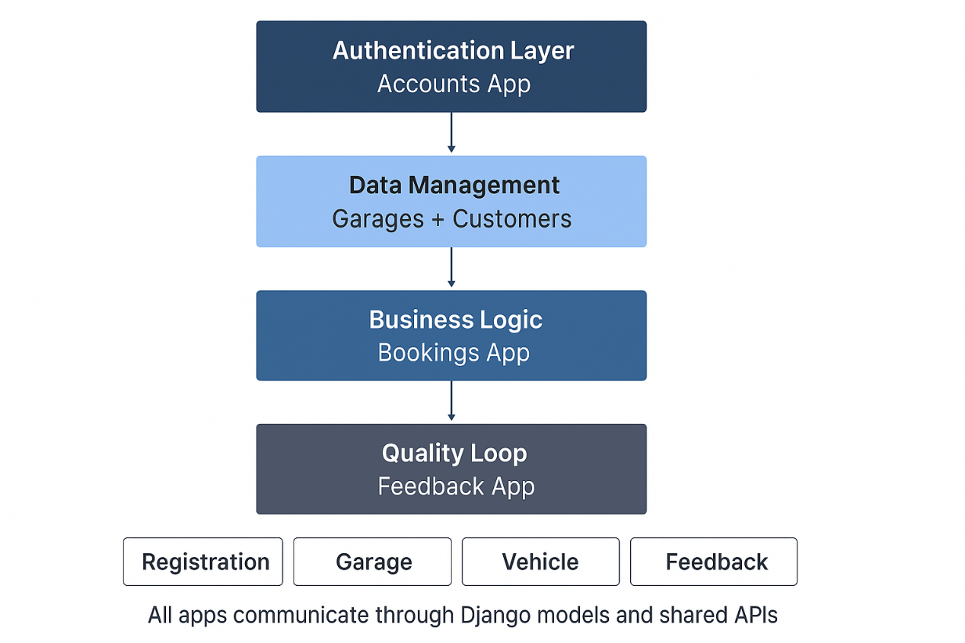
System Architecture

Slide 11
Future Scope
Payment Gateway Integration
AI Garage Recommendations
Real-time Vehicle Tracking
Multi-language Support

Slide 12
Conclusion
Car Care Hub delivers a smart, seamless, and future-ready solution that simplifies garage services for customers while empowering garage owners with efficient digital management.

Slide 13
Thank You!
We are excited to demonstrate how Car Care Hub modernizes garage management.
Questions?

